Slide 1
Decision Tree & Ensemble Methods

Slide 2

Day 4: Agenda
Introduction to Decision Trees
Decision Tree Structure
Decision Nodes and Leaf Nodes
Parent and Child Nodes
Splitting Criteria: Gini Impurity and Entropy
Tree Pruning and Overfitting
Techniques to Prevent Overfitting
Random Forest: Ensemble Learning and Bagging
Hands-On Practical Example: Decision Trees
Gradient Boosting and AdaBoost: Ensemble Methods

Slide 3
Decision Tree
Decision trees are hierarchical structures used for decision-making, classification, and regression tasks. They represent decisions, conditions, and outcomes in a visual tree format.
Use Cases:
Classification: Assigning data to predefined categories.
Regression: Predicting continuous values.
Feature Selection: Identifying important input features.
Importance in Decision-Making:
Interpretability: Easy to understand and interpret.
Transparency: Clear decision logic for better communication.
Efficiency: Handle various data types and missing values.
Ensemble Methods: Foundation for more advanced models.

Slide 4
Decision Tree Basics
Structure of a Decision Tree:
A decision tree consists of nodes, branches, and leaves. Nodes represent decisions/tests, branches represent outcomes, and leaves represent final decisions or class labels.
How Decision Trees Make Decisions:
Start at the root node.
Test an attribute/feature based on a condition.
Follow the branch that corresponds to the condition.
Repeat steps 2 and 3 at the next node until a leaf is reached.
The leaf provides the final decision or class label.
Decision trees make decisions by traversing the tree from the root to a leaf, evaluating conditions at each node to determine the path to follow.

Slide 5
Decision Nodes & Leaf Nodes
Decision nodes in a decision tree represent points where a decision or test is made on a specific attribute or feature.
They split the data into subsets based on the outcome of the test.
Leaf Nodes:
Leaf nodes in a decision tree represent final decisions or class labels.
They do not split the data further and provide the ultimate prediction or classification for the input.
Role of Decision Nodes:
Decision nodes guide the tree's structure by determining how data is divided into smaller subsets.
They enable the tree to make sequential decisions, leading to the final prediction or classification at a leaf node.

Slide 6
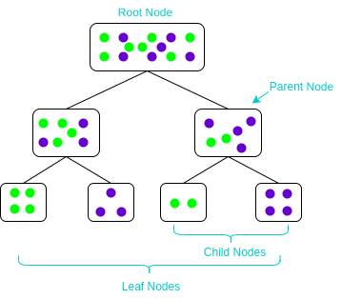
Parent & Child Nodes
Parent Nodes: Parent nodes in a decision tree are nodes that have branches leading to one or more child nodes. They represent the decisions or tests made at that level.
Child Nodes: Child nodes are nodes that stem from a parent node and represent the subsets of data resulting from the decision or test made at the parent node.
Relationships: Parent nodes guide the splitting of data into child nodes, creating a hierarchical structure in a decision tree. Each child node further refines the decision process based on the parent's test condition.

Slide 7
Splitting Criteria Overview
Splitting criteria are rules or metrics used to decide how to divide data at decision nodes in a decision tree. They help determine which attributes and conditions lead to the most effective data splits.
Impurity Measures: Impurity measures quantify the randomness or disorder within a dataset. Common impurity measures include Gini impurity, entropy, and misclassification error.
Importance in Decision Tree Construction: Choosing the right splitting criteria and impurity measures is crucial in decision tree construction. They help identify the best attribute to split on at each node, leading to a more accurate and efficient decision tree.

Slide 8
Gini Impurity
Gini Impurity as a Splitting Criterion:
Gini impurity measures the randomness or impurity of data in a node. It's used in decision trees to determine the best attribute for splitting data in classification tasks.
Calculation of Gini Impurity:
To calculate Gini impurity, square the proportions of each class in the node, sum them up, and subtract the sum from 1. Lower Gini impurity indicates purer nodes, helping the decision tree make better classification decisions.
Gini Impurity (Gini) = 1 - (p1^2 + p2^2 + ... + pk^2)
p1, p2, ..., pk are the proportions of each class in the node.
k is the total number of classes in the node.
This formula is used to assess the impurity or disorder in a node, with lower Gini impurity values indicating more pure nodes with predominantly one class.

Slide 9
Entropy
Entropy as a Splitting Criterion: Entropy measures data disorder and is used in decision trees for classification tasks.
Calculation of Entropy: H = - Σ (pi * log2(pi))
H is entropy.
pi is the proportion of each class in the node.
Sum over all classes.
Lower entropy indicates purer nodes, leading to better classification decisions.

Slide 10
Gini Impurity Vs Entropy
Aspect | Gini Impurity | Entropy
Measurement of Disorder | Measures impurity or disorder. | Measures impurity or randomness.
Formula | Gini = 1 - (p1^2 + p2^2 + ... + pk^2) | H = - Σ (pi * log2(pi))
Range of Values | Ranges from 0 (pure node) to 0.5 (maximal impurity). | Ranges from 0 (pure node) to 1 (maximal impurity).
Interpretation | Lower values indicate purer nodes, leading to better classification decisions. | Lower values indicate purer nodes, leading to better classification decisions.
Base | Based on squared class proportions. | Based on class proportions and logarithms.

Slide 11
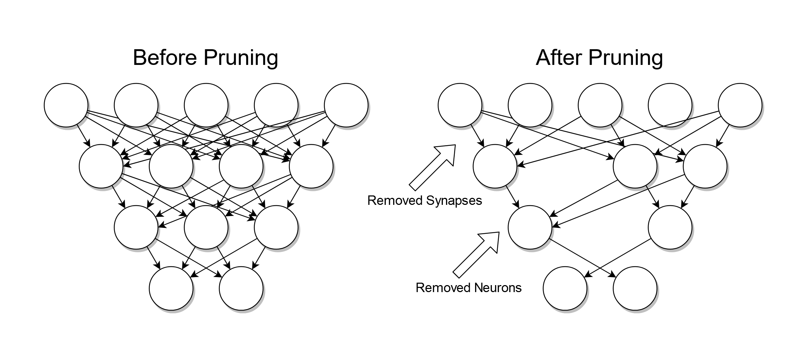
Tree Pruning
Definition: Trimming or simplifying a decision tree by removing branches or sub-trees.
Importance in Preventing Overfitting:
Eliminates noise and irrelevant details in the tree.
Reduces complexity to prevent overfitting.
Enhances generalization to unseen data.
Improves interpretability of the tree's decision-making process.

Slide 12
Techniques to Prevent Overfitting
Pruning: Trim the tree.
Min. Samples per Leaf: Set a limit.
Max. Depth: Restrict tree depth.
Min. Samples per Split: Define a minimum.
Max. Features: Limit feature consideration.
Ensemble Methods: Use multiple trees.
Cross-Validation: Assess performance.
Hyperparameter Tuning: Optimize settings.
Feature Engineering: Choose and preprocess features carefully.

Slide 13
Ensemble Techniques
Ensemble:
Combines predictions of multiple models.
Improves predictive accuracy and robustness.
Mitigates overfitting.
Ensemble Techniques:
Bagging: Constructs multiple models in parallel and combines their predictions (e.g., Random Forest).
Boosting: Builds a sequence of models, with each one correcting the errors of the previous (e.g., AdaBoost, Gradient Boosting).
Stacking: Trains multiple models and combines their predictions using another model (meta-learner).
Ensemble Averaging: Calculates the average of predictions from multiple models.

Slide 14
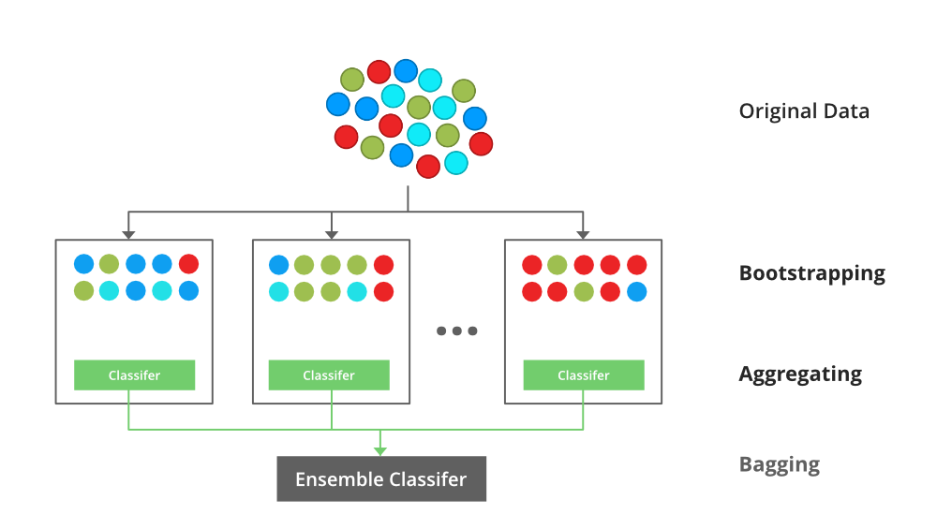
Random Forest
Ensemble learning method.
Combines multiple decision trees.
Enhances prediction accuracy and robustness.
Bagging Concept (Bootstrap Aggregating):​
Creates subsets of data through bootstrapping.​
Trains individual decision trees on these subsets.​
Averages predictions to reduce variance and overfitting.​
Random Forest adds feature selection randomness for improved performance.​

Slide 15
Random Forest Benefits
Advantages Over Single Decision Trees:
Reduced Overfitting: Aggregates predictions for improved robustness.
Improved Generalization: Better performance on unseen data.
Feature Importance: Ranks relevant attributes.
Outlier Robustness: Less sensitive to outliers.
Handling Variance and Bias:
Variance Reduction: Averages predictions for stability.
Bias Reduction: Captures complex relationships, enhancing accuracy.

Slide 16
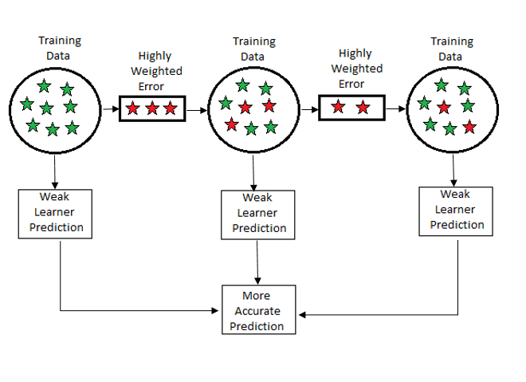
Gradient Boosting
Combines weak models sequentially.
Corrects errors made by previous models.
Creates a strong predictive model.
Concept of Boosting:
General ensemble technique.
Sequential model training.
Weights data points based on errors.
Focuses on challenging data for improved accuracy.

Slide 17
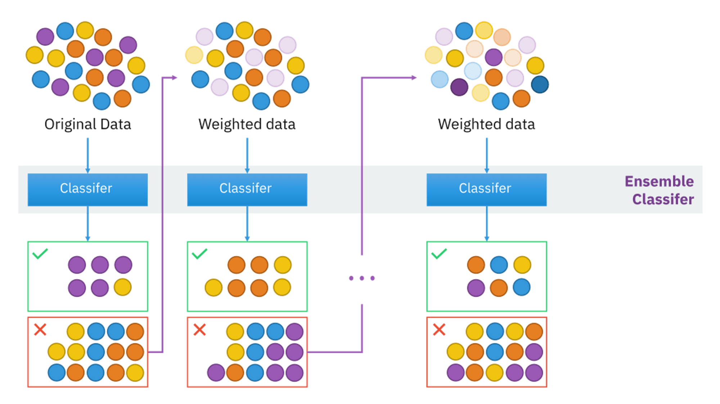
Gradient Boosting
Boosting technique for classification.
Combines predictions of weak learners.
Emphasizes challenging data points.
Weighted Training of Weak Learners:
Assigns weights to data points.
Focuses on misclassified samples.
Sequential training to correct errors.
Combines predictions with weighted votes.

Slide 18
Questions
Using the Iris dataset, build machine learning models based on Decision Trees, Random Forest, and Gradient Boosting.
Compare their performance. Additionally, train two separate Decision Trees and assess their performance.
Notes:
Note: Use – Jupyter File for this example - Decision Tree - Iris Dataset.ipynb

Slide 19
Questions ?

Slide 20
Thank You !

